Slide 1
Research Communication Skills
How to write survey papers

Slide 2
Intended Learning Outcomes
By the end of this lesson you will be able to:
  distinguish between original research and survey papers
  categorize research works into different categories
  write a survey paper

Slide 3
Where to find survey papers?
You can learn the structure and content of the surveys by studying existing survey papers
Have a look at the journal “ACM Computing Surveys”.
This is a journal dedicated to publishing survey papers.
Also other journals publish survey papers
Please find one or two surveys most related to your topic/research area

Slide 4
What is a Survey Paper?

Slide 5
A survey paper is…
As described by ACM Computing Surveys

Slide 6
A survey paper is…
"a paper that summarizes and organizes recent research results
As described by ACM Computing Surveys

Slide 7
A survey paper is…
"a paper that summarizes and organizes recent research results
As described by ACM Computing Surveys

Slide 8
A survey paper is…
"a paper that summarizes and organizes recent research results in a novel way
As described by ACM Computing Surveys

Slide 9
A survey paper is…
"a paper that summarizes and organizes recent research results in a novel way that integrates and adds understanding to work in the field.
As described by ACM Computing Surveys

Slide 10
A survey paper is…
"a paper that summarizes and organizes recent research results in a novel way that integrates and adds understanding to work in the field. A survey article assumes a general knowledge of the area;
As described by ACM Computing Surveys

Slide 11
A survey paper is…
"a paper that summarizes and organizes recent research results in a novel way that integrates and adds understanding to work in the field. A survey article assumes a general knowledge of the area; it emphasizes the classification of the existing literature,
As described by ACM Computing Surveys

Slide 12
A survey paper is…
"a paper that summarizes and organizes recent research results in a novel way that integrates and adds understanding to work in the field. A survey article assumes a general knowledge of the area; it emphasizes the classification of the existing literature, developing a perspective on the area,
As described by ACM Computing Surveys

Slide 13
A survey paper is…
"a paper that summarizes and organizes recent research results in a novel way that integrates and adds understanding to work in the field. A survey article assumes a general knowledge of the area; it emphasizes the classification of the existing literature, developing a perspective on the area, and evaluating trends."
As described by ACM Computing Surveys

Slide 14
A survey paper is…
"a paper that summarizes and organizes recent research results in a novel way that integrates and adds understanding to work in the field. A survey article assumes a general knowledge of the area; it emphasizes the classification of the existing literature, developing a perspective on the area, and evaluating trends."
As described by ACM Computing Surveys

Slide 15
What survey paper is NOT
A summary of existing techniques

Slide 16
What survey paper should have
The collective analysis of all the existing techniques
A storyline linking different research papers
The development in the specific problem domain

Slide 17
Original research vs. survey paper
Original research papers are a description of your own research.
A survey paper is a service to the scientific community.
You are doing their research for them. Instead of reading 20+ papers to understand what a scientific topic is about, they just need to read your paper.

Slide 18
Goals of a Survey
For you - give you the opportunity to become closely familiar with the current work being done in a particular area
For your reader - provide with a view of existing work that is well organized and comprehensive
  Not all details must be included, which one’s should/shouldn’t?
  Make sure to cover all relevant material completely
  Logical structure of organization
  State-of-the-art view

Slide 19
Challenges of writing a survey paper
pick representative papers from within the research area and summarize them concisely
ensure that your survey paper is easily understandable

Slide 20
Pick representative papers from within the research area and summarize them concisely

Slide 21
How to pick articles
There may be hundreds or thousands of papers available and you have only a few pages to capture the key work in the field.
You will need to read the abstracts and conclusions for a relatively large number of papers and select a subset that covers your selected topic area for detailed reading and presentation in your survey.

Slide 22
How to pick articles
Which subjects should you write a survey about:
  recent advances on one of the open and interesting topics related to your research area
  fields which are on the verge of maturity, but do not yet qualify for a book
Which subjects you should NOT write a survey about:
  If there are less than 10 scientific papers in a field
  If all the 10 are from the same author
  If there is already an exhaustive, recent survey
Check again your proposed group’s topic – does it qualify as a good candidate to write a research survey about? If not – keep thinking and coming up with new ideas.

Slide 23
How to pick articles
When picking papers to read - try to:
  Pick a recent survey of the field so you can quickly gain an overview,
  Pick a paper that you can understand easier – book chapters often give easier understandable materials and lengthy explanation that may give you a head start, although they may not be as up-to-date as papers

Slide 24
How to pick articles
When picking papers to read - try to:
  Pick papers that are related to each other in some ways and/or that are in the same field so that you can write a meaningful survey out of them,
  Read the abstracts and conclusions for a relatively large number of papers and select a subset that covers your selected topic area

Slide 25
How to pick articles
When picking papers to read - try to:
  Favour papers from well-known journals and conferences,
  Favour “first” or “foundational” papers in the field (as indicated in other people’s survey paper)
  Favour more recent papers
  Pick heavily cited papers

Slide 26
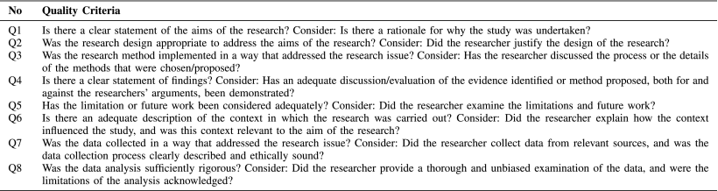
Eight questions (or quality criteria) to evaluate the quality of primary studies

Slide 27
How to pick articles
When picking papers to read - try to:
  Once you have identified an interesting technology to report upon, follow developments in that strand of technology (e.g. time-wise and technology-wise developments).
  Find relationships with respect to each other and to your topic area (classification scheme/categorization)

Slide 28
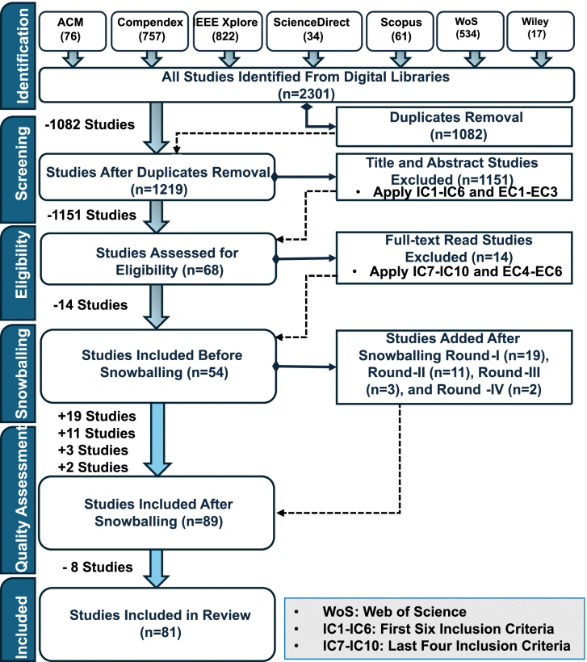
PRISMA flow for primary studies selection
https://ieeexplore.ieee.org/document/11145241

Slide 29
Ensure that your survey paper is easily understandable

Slide 30
Tips
Allocate sufficient time for the reading of the papers not just for the writing of your survey
  Make sure that you, the writer, understand the papers you are surveying.
Adopt easy to understand article structure - define/explain all terms used and present information in a logical order. The use of diagrams with in-text explanations is very important.

Slide 31
Some questions you might ask yourself when reading papers and categorizing them
which one of the 3-4 big research directions they tell?
what approaches/mathematical techniques /algorithms etc they rely on?
is this a theory or application paper?
is it the continuation of another work? is it an improvement on another work?
do they use theoretical proofs? simulation? hardware testbed? Real life deployment?
which other technology they compare themselves with? In which way are they better? Note: all the papers you will encounter are at least in some ways better than others. You need to identify the authors claim; higher performance (under certain assumptions)? higher robustness? lower computational complexity?
…

Slide 32
Article Structure
It should not be just a series of paper reviews
A typical structure of a paper includes:
  Title
  Abstract
  Introduction
  Body of paper
  Conclusion/Future Work
  References

Slide 33
Article Structure – Introduction
Importance and significance of the topic –
  Why the field - and the specific problem - matters in a larger context - establishing the motive for the survey paper – research challenges
Discuss the background and target audience
Summarize the surveyed research area and explain why the surveyed area has been studied
  Define the field and the scope of the paper
    Define key terms
Summarize the classification scheme you used to do the survey
Summarize the surveyed techniques with the above classification scheme

Slide 34
Introduction - terminology and definitions
In each research domain, the researchers use some common terminology to describe important concepts
Some researchers however, invent specific new terms for the same concept
In your notebook – while reading the papers
  clarify these things
  start by keeping a note of the various terms while you are reading papers
In the Introduction section – while writing your paper
  Introduce the terminology of the field, describe what the various terms mean
  Also remember to map the terminological variations

Slide 35
Introduction – research challenges
The description of the various research challenges of the field - the hardest to write, because it is the part which is creative
Start by noting out the various objective descriptions from various papers
But it is not enough to just put them together: you need to rewrite them in your own words.
  Copyright/plagiarism
  you need to write it in a way that covers all the papers not just one
It is helpful to identify 3-4 main research directions, around which you will organize your papers

Slide 36
Article Structure - Survey details/Body of paper
Present the surveyed techniques using the classification scheme in detail
Identify the trends in the surveyed area. Give evidences for your decision
Identify some leading research/products/companies/web-sites
Identify the unresolved problems/difficulties, and future research issues

Slide 37
Article Structure - Survey details/Body of paper - tips
Logical order for moving from one method to another
Each approach defined clearly at the start of each section
Shares motivation for each method
Give a high-level overview of each approach, then specific approaches
Discuss how the approach or technique evolves over time
How the approach is applied
Note specific areas of improvement
Usually is at least one method is visualized in a figure

Slide 38
Article Structure
Conclusions/Future work
  Summarize the conclusions of your survey
  Identify emerging areas and promising methods for future research
References
  List all the citations referenced in your paper

Slide 39
Common elements of the survey
Basic approaches and mechanisms
Figures to explain the general area or basic techniques
Proposed/ in use application level protocols/standards/solutions
A tree/table to show the classification
Relative advantages/disadvantages between the classified techniques and standards

Slide 40
Common elements of the survey
Basic approaches and mechanisms
Figures to explain the general area or basic techniques
Proposed/ in use application level protocols/standards/solutions
A tree/table to show the classification
Relative advantages/disadvantages between the classified techniques and standards

Slide 41
Visual presentation of information
Can be taken from papers as long as appropriate credit is given
  “Figure taken from [28]”.
Draw your own figures to show classification or structure of the survey
Use tables to organize comparisons between applications/systems/etc

Slide 42
Visual presentation of information
Can be taken from papers as long as appropriate credit is given
  “Figure taken from [28]”.
Draw your own figures to show classification or structure of the survey
Use tables to organize comparisons between applications/systems/etc

Slide 43
Tables
Maintain the same schema throughout the article
Table must be referenced and connected to the text
Should convey only key information
Tables should do something to forward your argument
  Can help provide a very broad overview of the problem and how it’s approached
  Can also show key works and how they progress
  Can be useful for categorizing information

Slide 44
Figures
Maintain same schema throughout the entire article
Needs to be referenced in and connected to the text
Should do something to forward your argument
  Illustrate key concepts
  Illustrate useful examples
  Represent data visually
  Flow charts can be great ways to see processes

Slide 45
Survey paper formatting
For your group’s survey papers, you can follow the guidelines in this template:
https://www.acm.org/binaries/content/assets/publications/taps/acm_submission_template.docx
Management/economic field
https://onlinelibrary.wiley.com/journal/14676419
https://onlinelibrary.wiley.com/doi/epdf/10.1111/1467-8551.00375

Slide 46
Summary
To write a good survey paper, you should:
  Read a lot to pin down your list of papers
  Remember that the titles that you first picked don’t have to end up in your survey paper, use what’s useful
  Be aware and okay that your topic will evolve as your research leads you to other places
  Choose your works based on its usefulness to the end goal: your survey paper. This saves you time!

